Slide 1

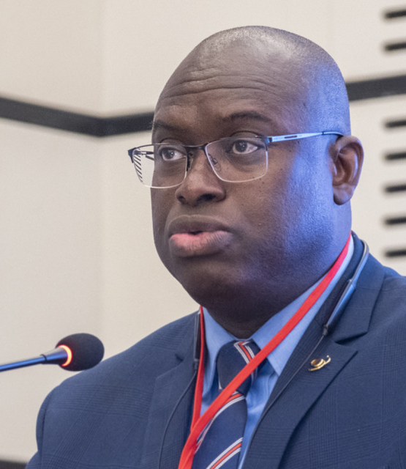

BUILDING RESILIENT
AND SUSTAINABLE
SYSTEMS
----------------
GMES & Africa PERSPECTIVE
Dr. Tidiane Ouattara
  Coordinator African Outer Space Programme and GMES & Africa
  Department Education, Science, Technology, and Innovation (ESTI)
  African Union Commission
AfriGEO Symposium 2022
31 OCTOBER 2022 | ACCRA| GHANA

Slide 2


A System is a group of interacting or interrelated elements that act together as a whole to accomplish an action. It has its purpose, boundaries, structure and rules of functioning
RESILIENT AND SUSTAINABLE SYSTEMS
Resilience of a System is its capacity to absorb disturbance and reorganize while undergoing change so as to still retain essentially the same function, structure, identity, and feedbacks
System sustainability resides in its capability to continue efficiently working despite the changes
Notes:
Slide 10
AFRCA is a new global player as the new eldorado for space business. In Africa, all is to be done for African huge resources efficient management. Indeed, space is in the heart of the digitalization, the efficient value-added management
of the african natural resources. It is also the key tool for knowledge management and adaptation to the climat change and disaster risk reduction as well as assuring food security.

Slide 3


AU-EU Collaboration on Space applications
A unique historical continuity
Phase 1
Dec. 2016 – Dec. 2021
Phase 2
Jan. 2022 – Dec. 2025

Slide 4








GMES AND AFRICA : A SYSTEM OF SYSTEMS
Develop Access to Data and Information Services (Infrastructural and Information Systems)
Contribute to Policy and Institutional Framework (Institutional System)
Develop Regional and National Training Capacities (Training Systems)
Raise Awareness among Users and Communities (Communication Systems)

Slide 5


GEOGRAPHYCAL AND PHYSICAL BOUNDARY: AFRICA, OUR AFRICA
Huge and diversified human and natural Capital in our hands
55 countries = 30 million km²
Second largest continent, 6% of world superficies and 20 % emerged land
More than 1.216 billion inhabitants*
17.5% of the world population*
*2016

Slide 6

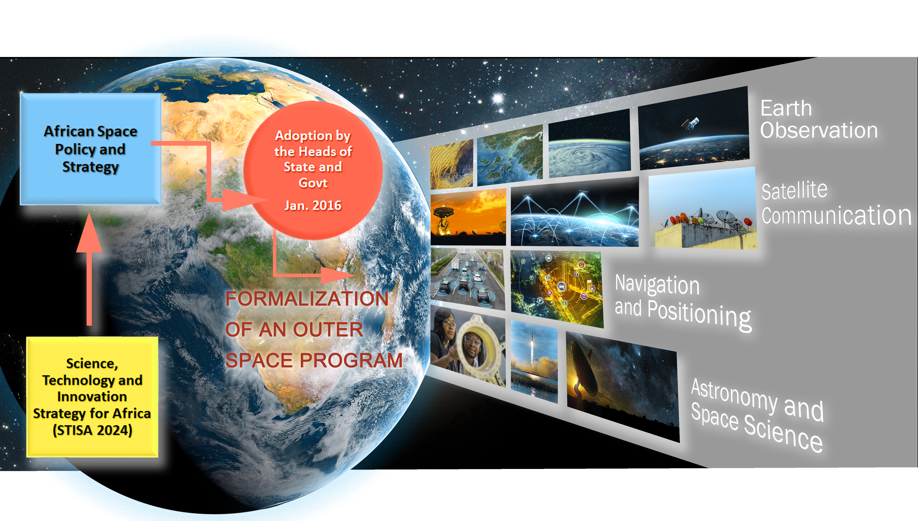
THE AFRICAN OUTER SPACE PROGRAM: A FLAGSHIP of the African Union
POLICY AND INSTITUTIONAL BOUNDARIES OF GMES & AFRICA
SPACE: A KEY DRIVER
OF THE AGENDA 2063
African Space Agency
Notes:
Slide 9
The African Outer Space Program is a Flagship of The African Union. It is a key driver of the agenda 2063 implementation towards an integrated, prosperous and peaceful Africa, driven by its own citizens and representing a dynamic force in the global arena. The AU Space Policy and Strategy is one of the implementation legs of the AU Science, Technology and Innovation Strategy for Africa (STISA 2024).
The African Outer Space Program covers earth observation, satellite communication, Navigation and Positioning and, Astronomy & Space Science per se.

Slide 7
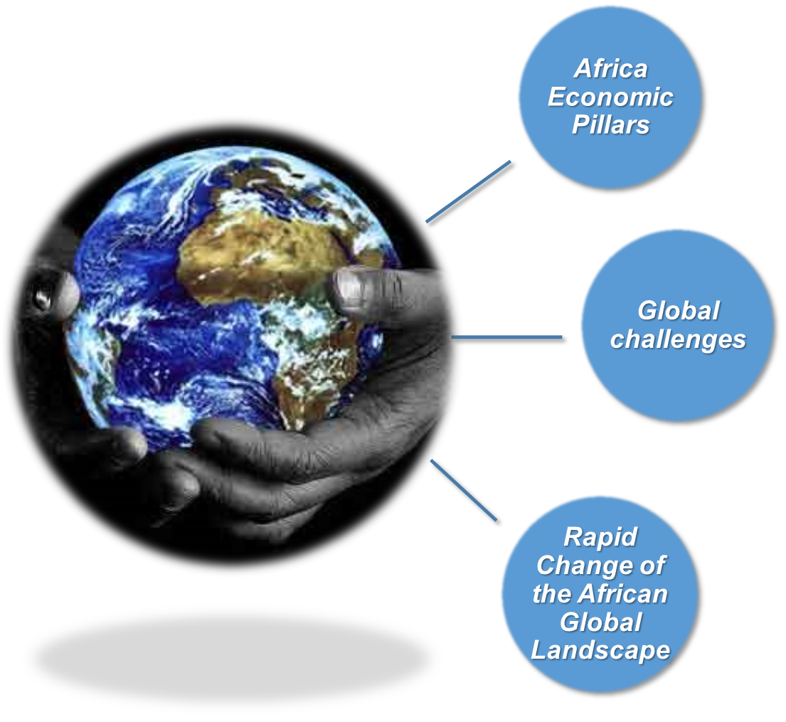





GMES & AFRICA SYSTEM PURPOSE
THE AFRICAN SUSTAINABLE DEVELOPMENT CONTEXT
AGENDA 2063: THE AFRICA WE WANT
CHARACTERISTICS
Multifaceted
Interlinked
Transcend national boundaries
Cannot be addressed by government single handedly
INTEGRATED – PROSPEROUS and PEACEFUL AFRICA
Notes:
CAUSE AND EFFECT RELATIONSHIP: THREATS OF AFRICA DEVELOPMENT
Africa growth is threaten by the increasing impact of human activities, potentiated by several cross cutting issues, that leads to degradation of environment.
Such degradation trigger several security situations in Africa: Migrations, Food insecurity, Conflicts, Poverty and Health Problems and Natural disasters which, retrospectively, contribute to increase what natural resources and human habitat degradation.

Slide 8




GMES & AFRICA SYSTEM PURPOSE
EO KNOWLEDGE CONTRIBUTION TO AFRICAN SUSTAINABLE DEVELOPMENT
CHALLENGES OF AFRICAN DEVELOPMENT
Ground Segment
Space Segment
Service Segment
Africa Economic Pillars
  Agriculture, Natural Resources and Water
  Energy
  Blue Economy
  Digital Infrastructure
POLICY & REGULATORY DEVELOPMENT AND IMPLEMENTATION
SOCIOECONOMIC INFRASTRUCTURES AND SERVICES
EARTH OBSERVATION DOMAIN
  Climate change and variability
  Disaster Risk Reduction
  Post-2015 on Sustainable Development
  Security : terrorism and piracy
Global challenges
SECURITY OF PEOPLE, TERRITORIES AND GOODS
Notes:
Making Africa The New Hotspot Foe Space Business NECESSITATE that SPACE be positioned in the heart of the African Sustainable Development.

Slide 9



SOME OF THE GMES & AFRICA FUNCTIONNG RULES AND GUIDELINES
4 year period
Inclusion of women
Youth involvement
Duration of 48 months
30% of Women
Through Master and PhD students - Internships
January 2022 - December 2025
Cross-fertilization
Communication
Private Sector
Synergies and Knowledge sharing
10% Communication
20% of the budget

Slide 10
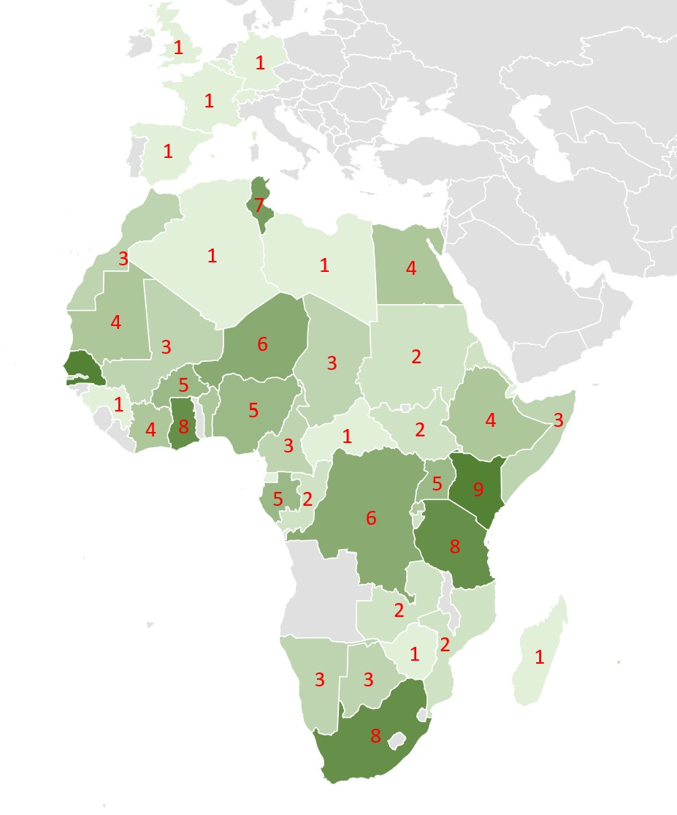
Research Centres (17)
Regional Organizations (4)
Public Institutions (69)
Private Sector (3)
NGOs (17)
International Organizations (6)
Intergovernmental Organizations (IGO) (6)
Academia (45)
I. GMES & AFRICA INSTITUTIONAL ECOSYSTEM
Nb of Institutions
x Consortium
Nb of Institutions x Region
Phase 1 & 2
All actions considered
167 Institutions
Notes:
As of today, through its grants scheme, GMES and Africa Phase 2 encompasses 91 Institutions (without the associates)
Half of them are Public Services, the rest includes Academia, NGOs, Private Companies, etc.
On the top of this, there are the Institutions that were delivered with eStations and the Academia and that are in the network of EN FR Universities
The current total is 105 without the associates
When we sum phase 1 and phase 2, this brigs the total to 167, without the associates of the Consortia of the Grant Phase 2
SADC has been excluded

Slide 11
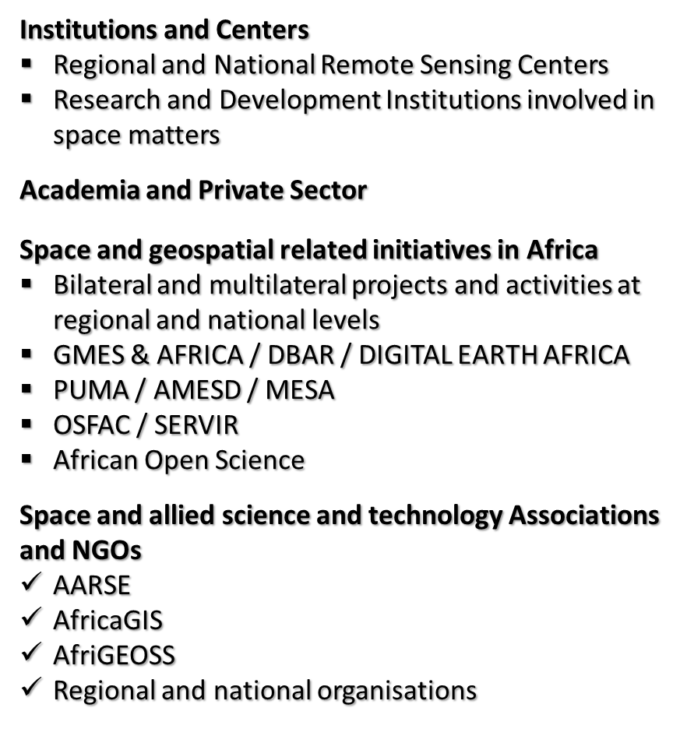

I.1. African Earth Observation Ecosystem
Notes:
Talk about Rwanda and other countries that recently established space program. Ethiopia, Uganda, Zimbabwe, Botswana, Djibouti, etc.

Slide 12
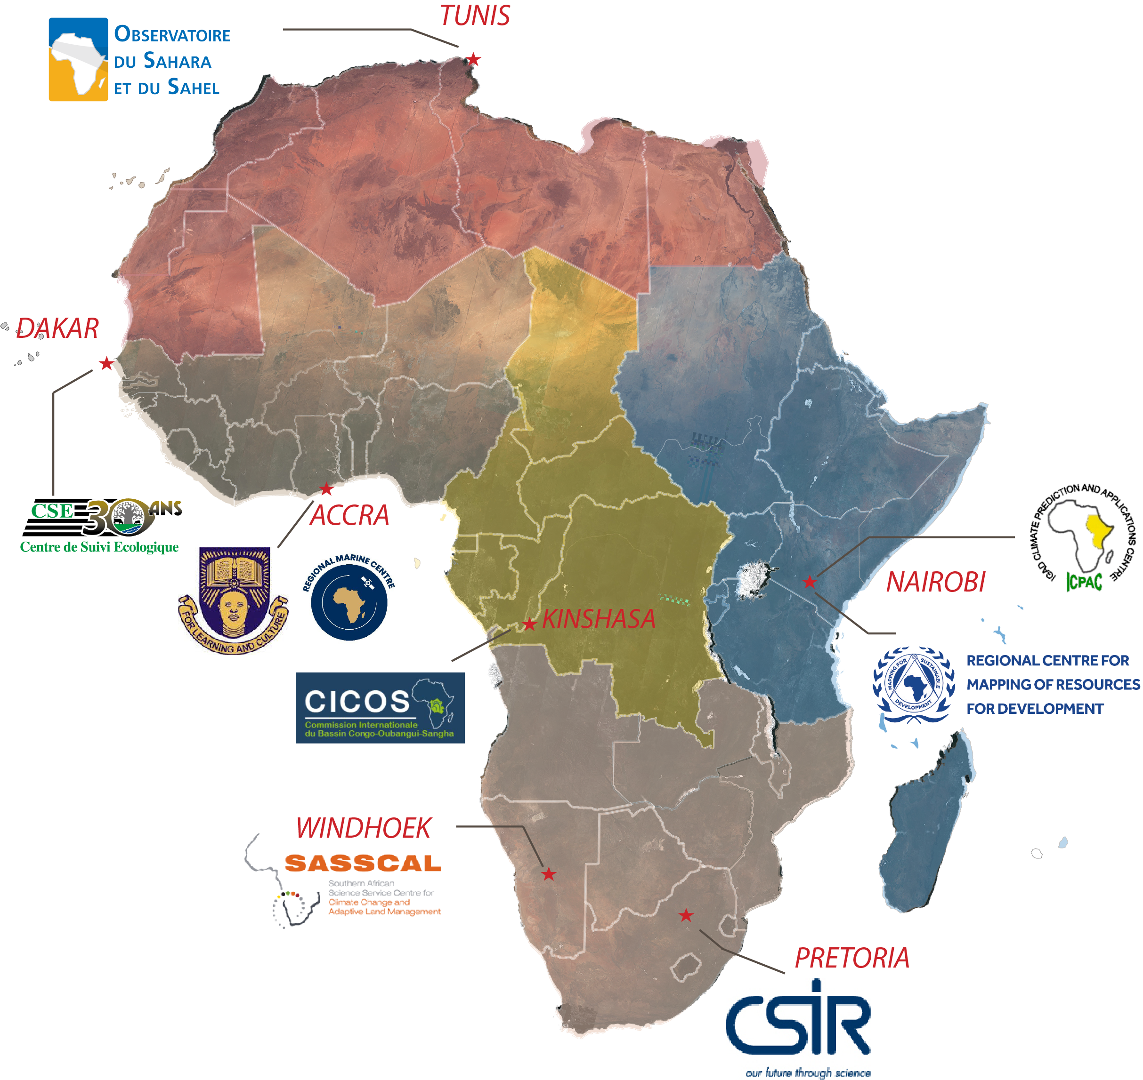
I.2. GMES & AFRICA Functional Systemic Structure
Notes:
GMES and Africa is building on precursors PUMA, AMESD and MESA
An Eco System s in place, made of capacities human capacities, material capacities, and skills.
GMES intent is to continue developing it, take care on progress in the technologies, and capitalize, valorize it.

Slide 13
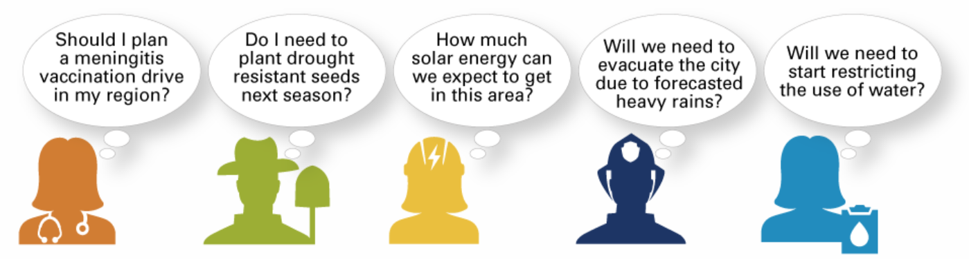









How do Climate services work*?
I.3. SYSTEMIC Services Delivery
Users’ Survey
and engagement
Health
Farming
Energy
Civilian security
Water
Needs
A Bottom up-Top down, user-driven approach
Tailored products/services
Key indicators
Modelling
Data
Acquisition of Space data
and In-situ measurements
Source GFCS: http://www.wmo.int/gfcs/what-are-climate-services
Slide 13
Notes:
Climate services equip decision makers in climate-sensitive sectors with better (climate) information to help society, individuals and organizations, adapt to climate variability and make climate smart decisions.
National and international databases provide high quality data on temperature, rainfall, wind, soil moisture and ocean conditions, as well as maps, risk and vulnerability analyses, assessments, and long-term projections and scenarios.
Socio-economic variables and non-meteorological data such as agricultural production, health trends, human settlement in high-risk areas, road and infrastructure maps for the delivery of goods, may be combined, depending on user needs.
The data and information collected is transformed into customized products such as projections, trends, economic analysis and services for different user communities.

Slide 14
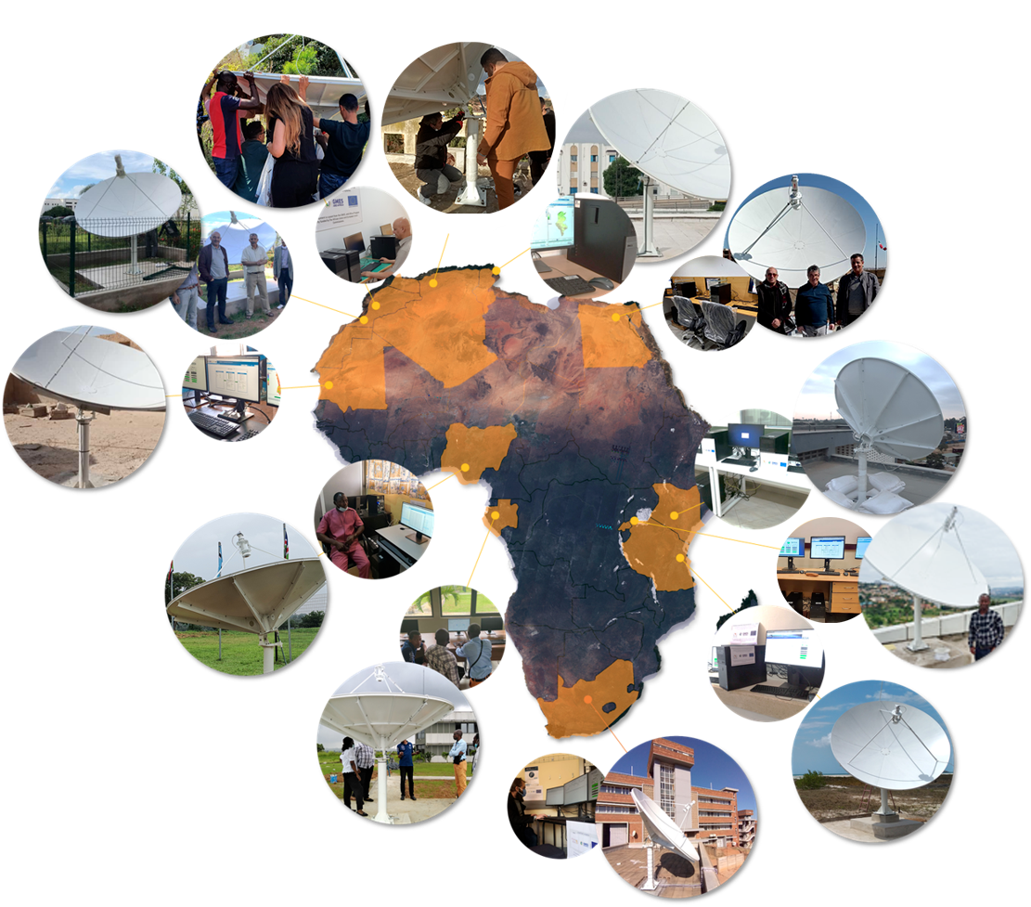
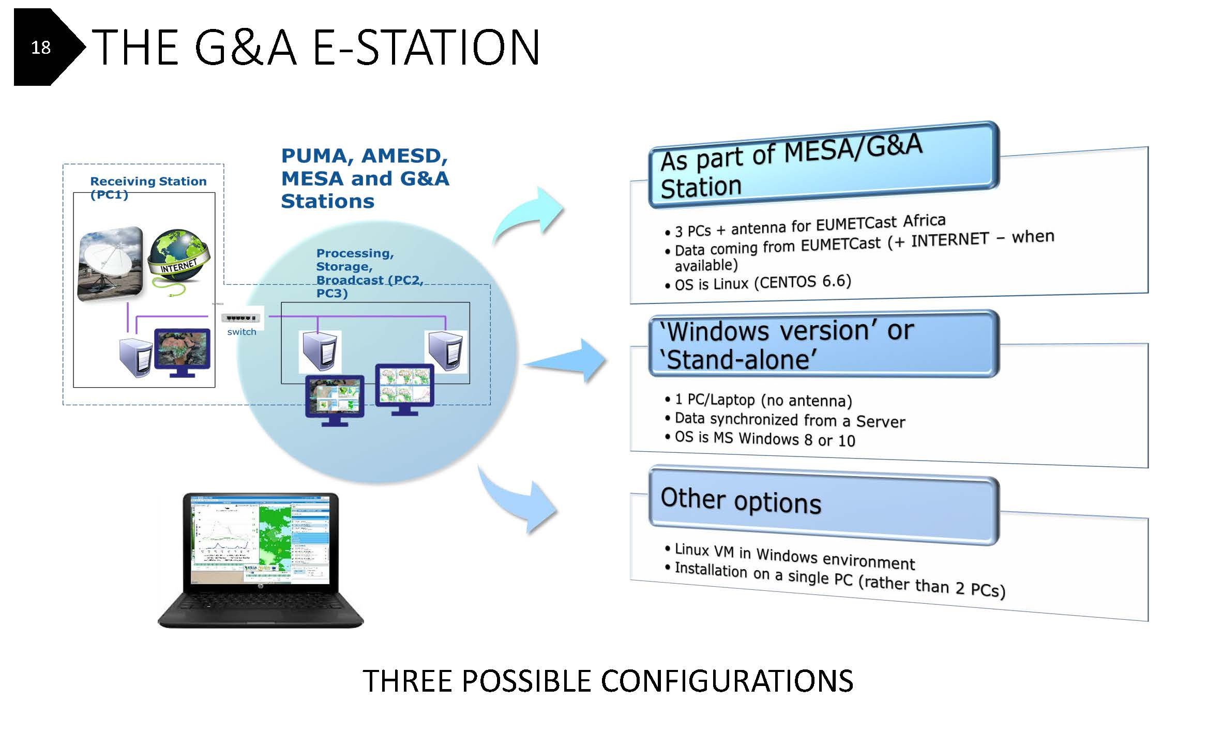
*** BUILDING ON EXISTING 188 eSTATIONS
II. GMES & AFRICA DATA, INFRASTRUCTURE AND SERVICE DELIVERY SYSTEM
II.1 Data acquisition and processing
North A.
1 in Algeria (CTS/ASAL)
1 in Egypt (NARSS)
1 in Mauritania (IMROP)
2 in Morocco (CRASTE-LF, UCD)
1 in Tunisia (CNCT)
12 eStations delivered (eStations)
48 operators trained
East A.
1 in Kenya (RCMRD)
1 in Rwanda (RWB)
1 in Tanzania (SOAF)
West A.
1 in Nigeria (CSSTE)
Central A.
1 in Gabon (AGEOS)
Southern A.
1 in South Africa (CSIR)
Notes:
Station per Region
North 6 (50%) West 1 (8%) Central 1 (8%) East 3 (25%) South 1 (8%)

Slide 15
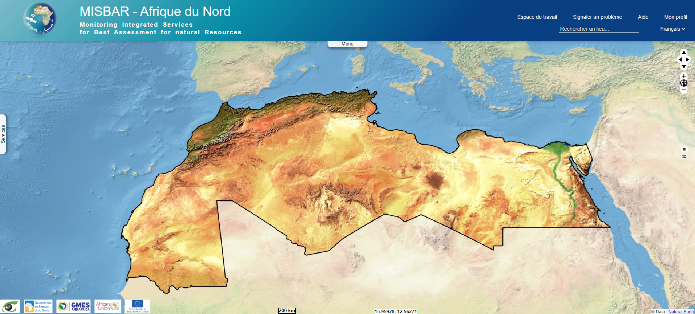




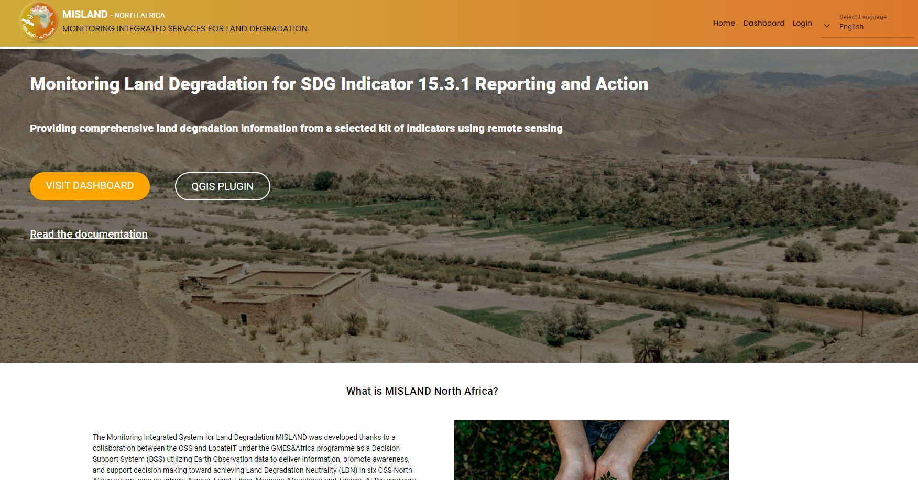
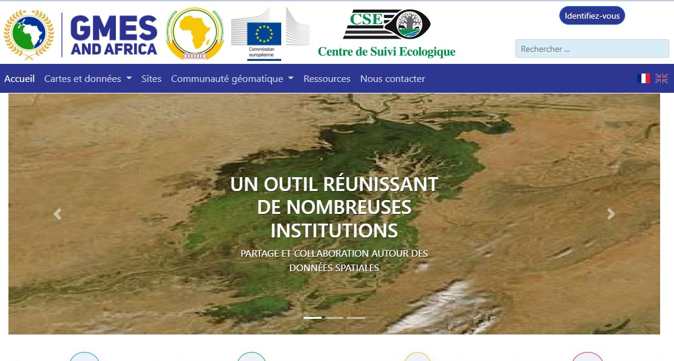
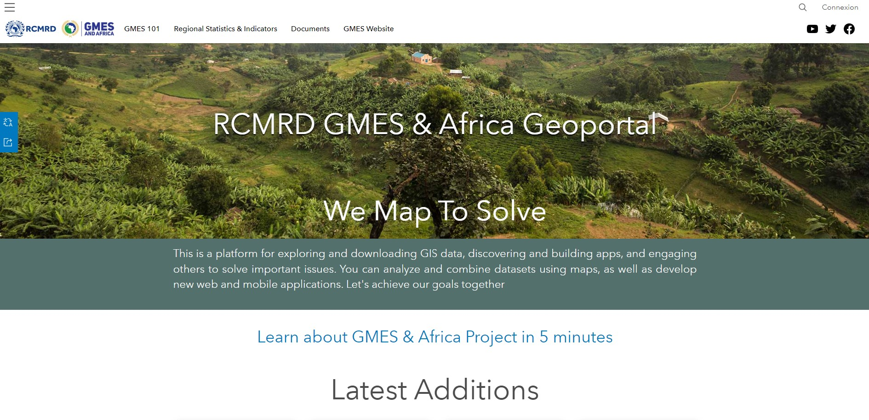
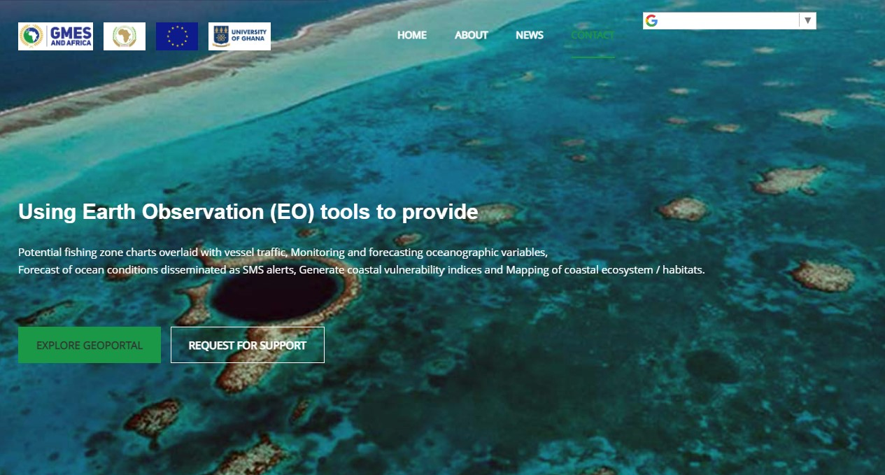
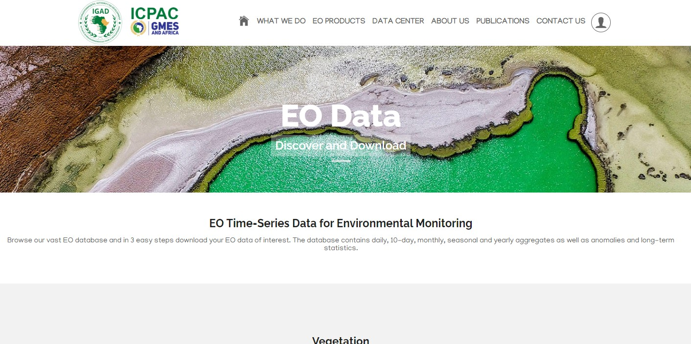
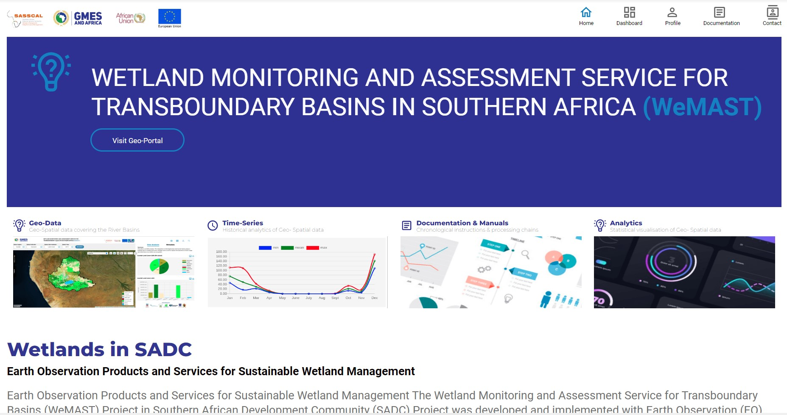
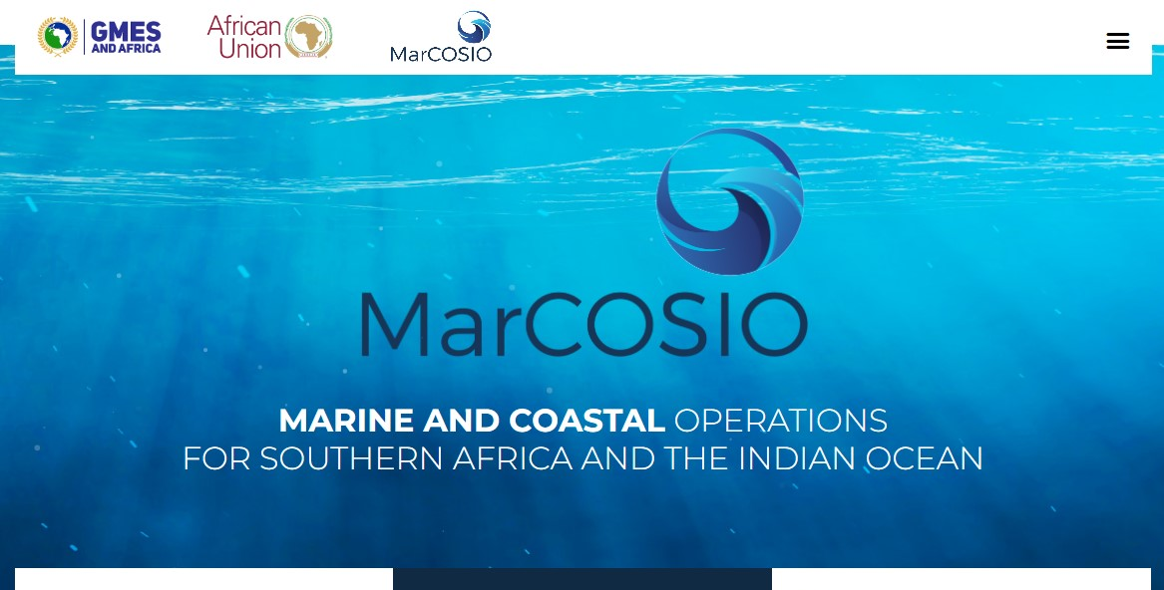
II. 2. GEOPORTAL: Data and Information Access and Dissemination
OSS (Tunis)
http://misland.oss-online.org
http://misbar.oss-online.org
(Water & Natural Resources)
(Northern Africa)
CSE (Dakar)
http://gdzhao.gmes.cse.sn/
(Water & Natural Resources)
(Western Africa)
RCMRD (Nairobi)
https://gmesgeoportal.rcmrd.org
(Water & Natural Resources)
(Eastern Africa)
ICPAC (Nairobi)
http://gmes.icpac.net/data-center
(Water &Natural Resources)
(Eastern Africa)
UOG-RMC (Accra)
http://geoportal.gmes.ug.edu.gh/
(Marine & Coastal)
(Western and Northern Africa)
CSIR (Pretoria)
https://marcosio.org/
(Marine & Coastal)
(Southern & South-West Indian Ocean Africa)
SASSCAL (Windhoek)
http://gmes-geoportal.sasscal.org
(Water & Natural Resources)
(Southern Africa)

Slide 16
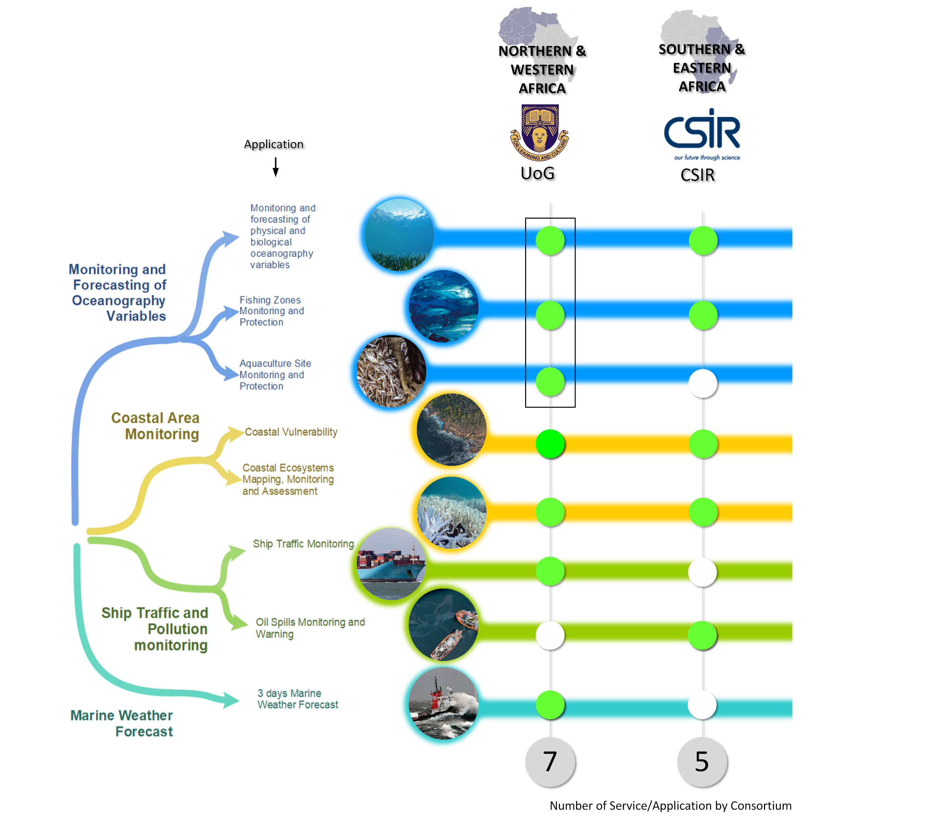

II.4.1. Marine & Coastal Areas
II.4 GMES & AFRICA INFORMATION SERVICES SYSTEM
Consortia x Systems

Slide 17
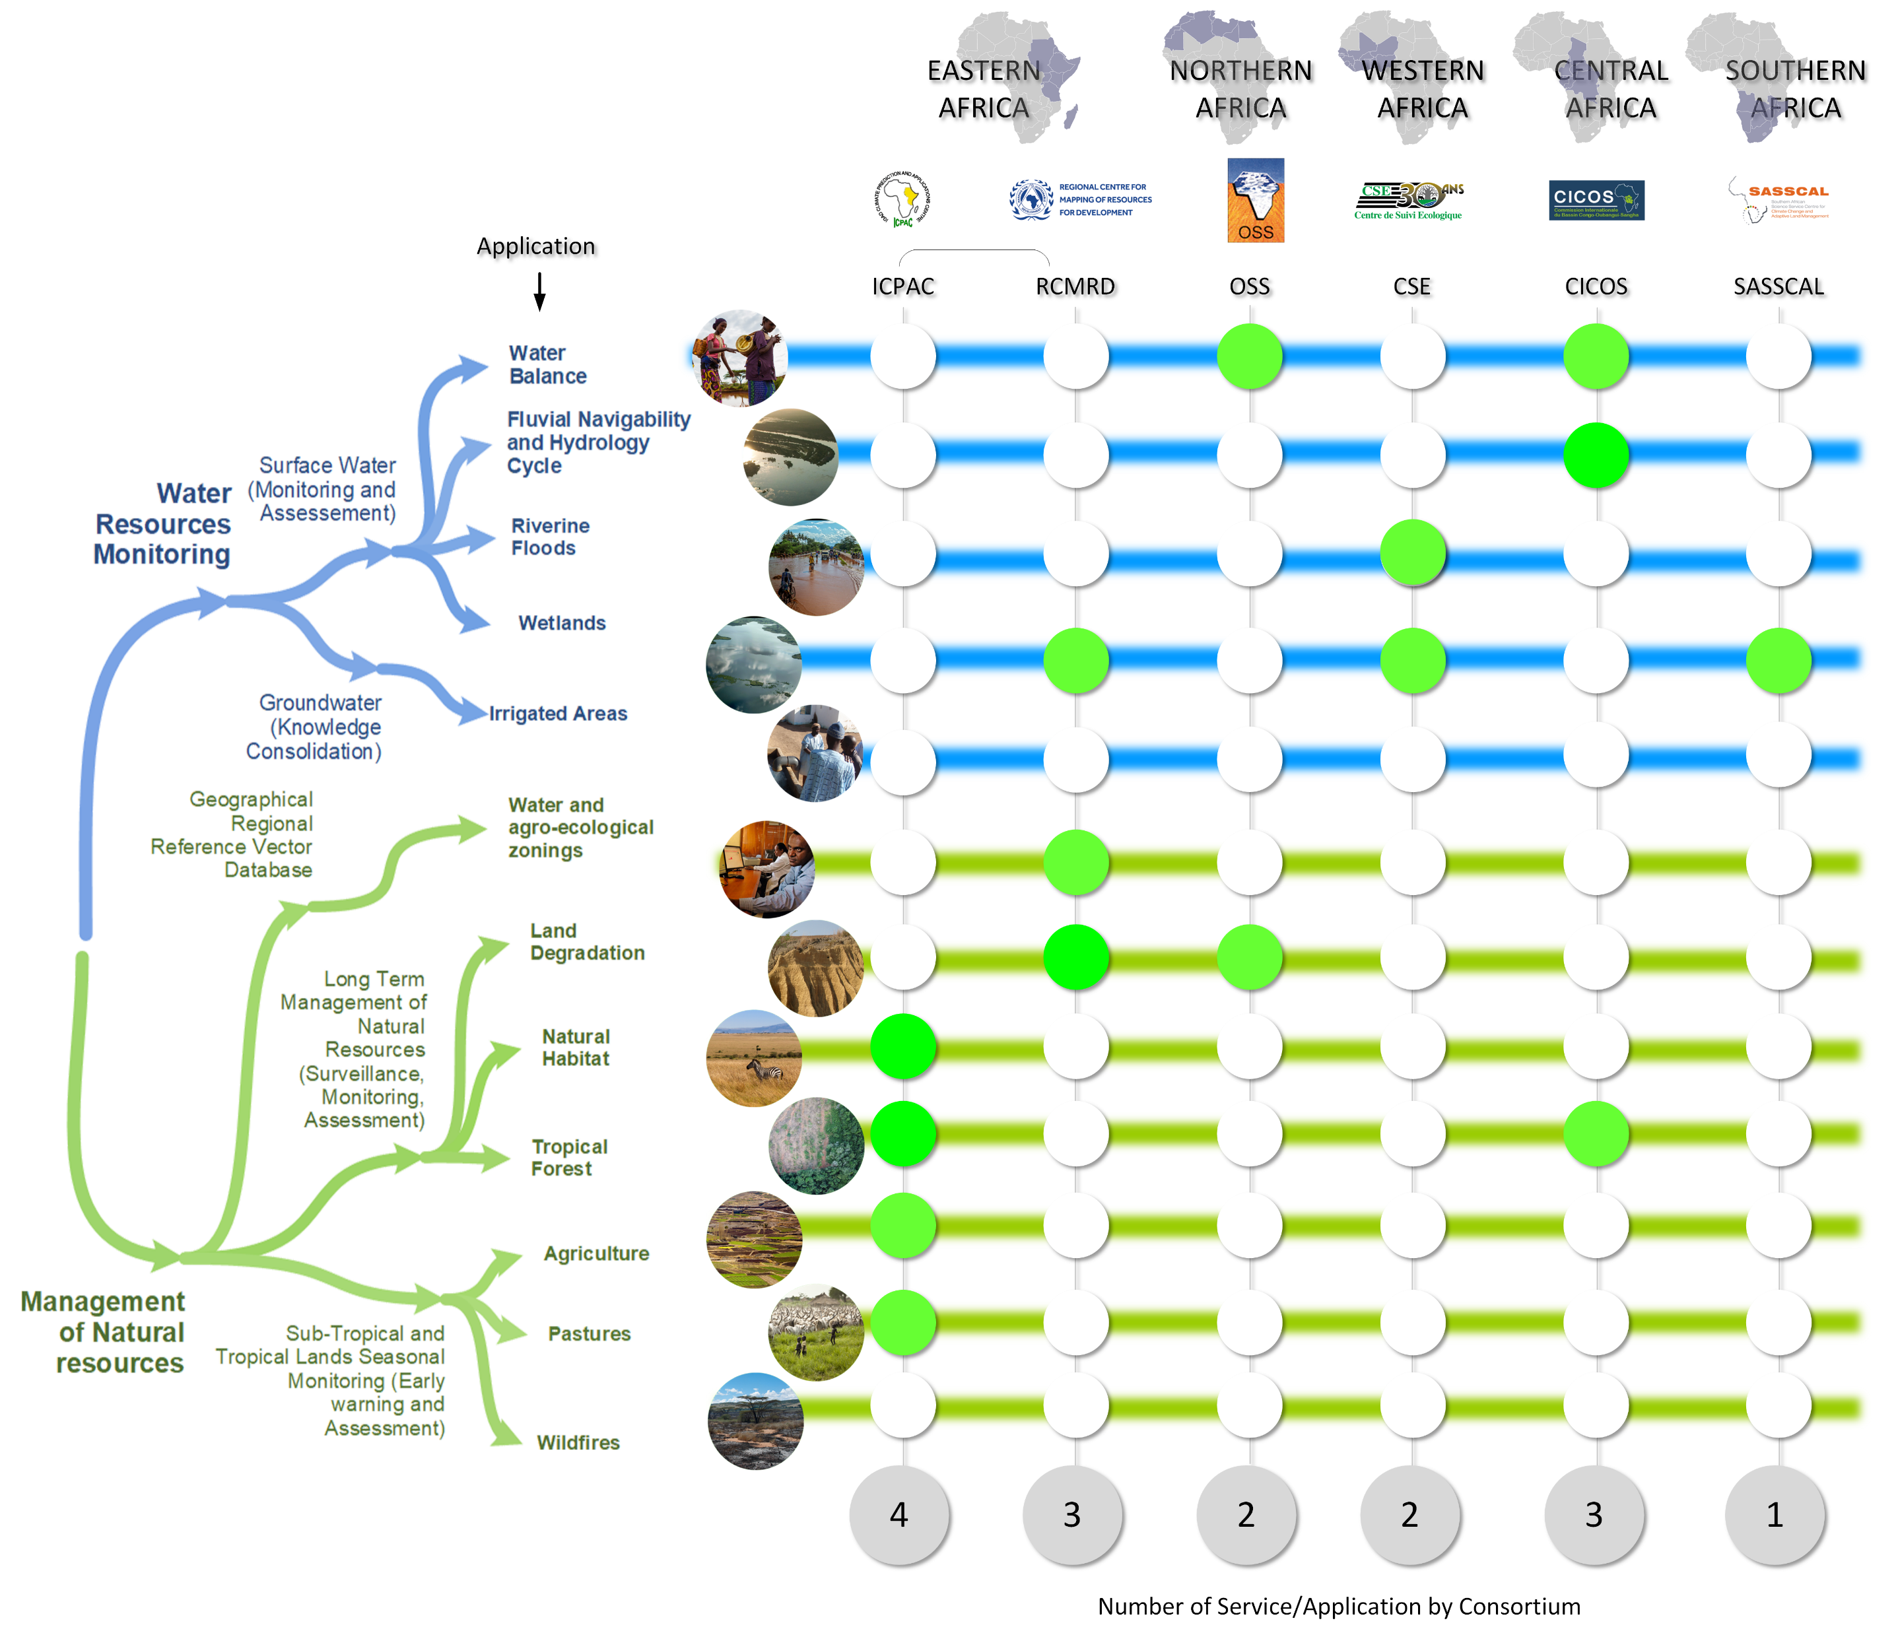
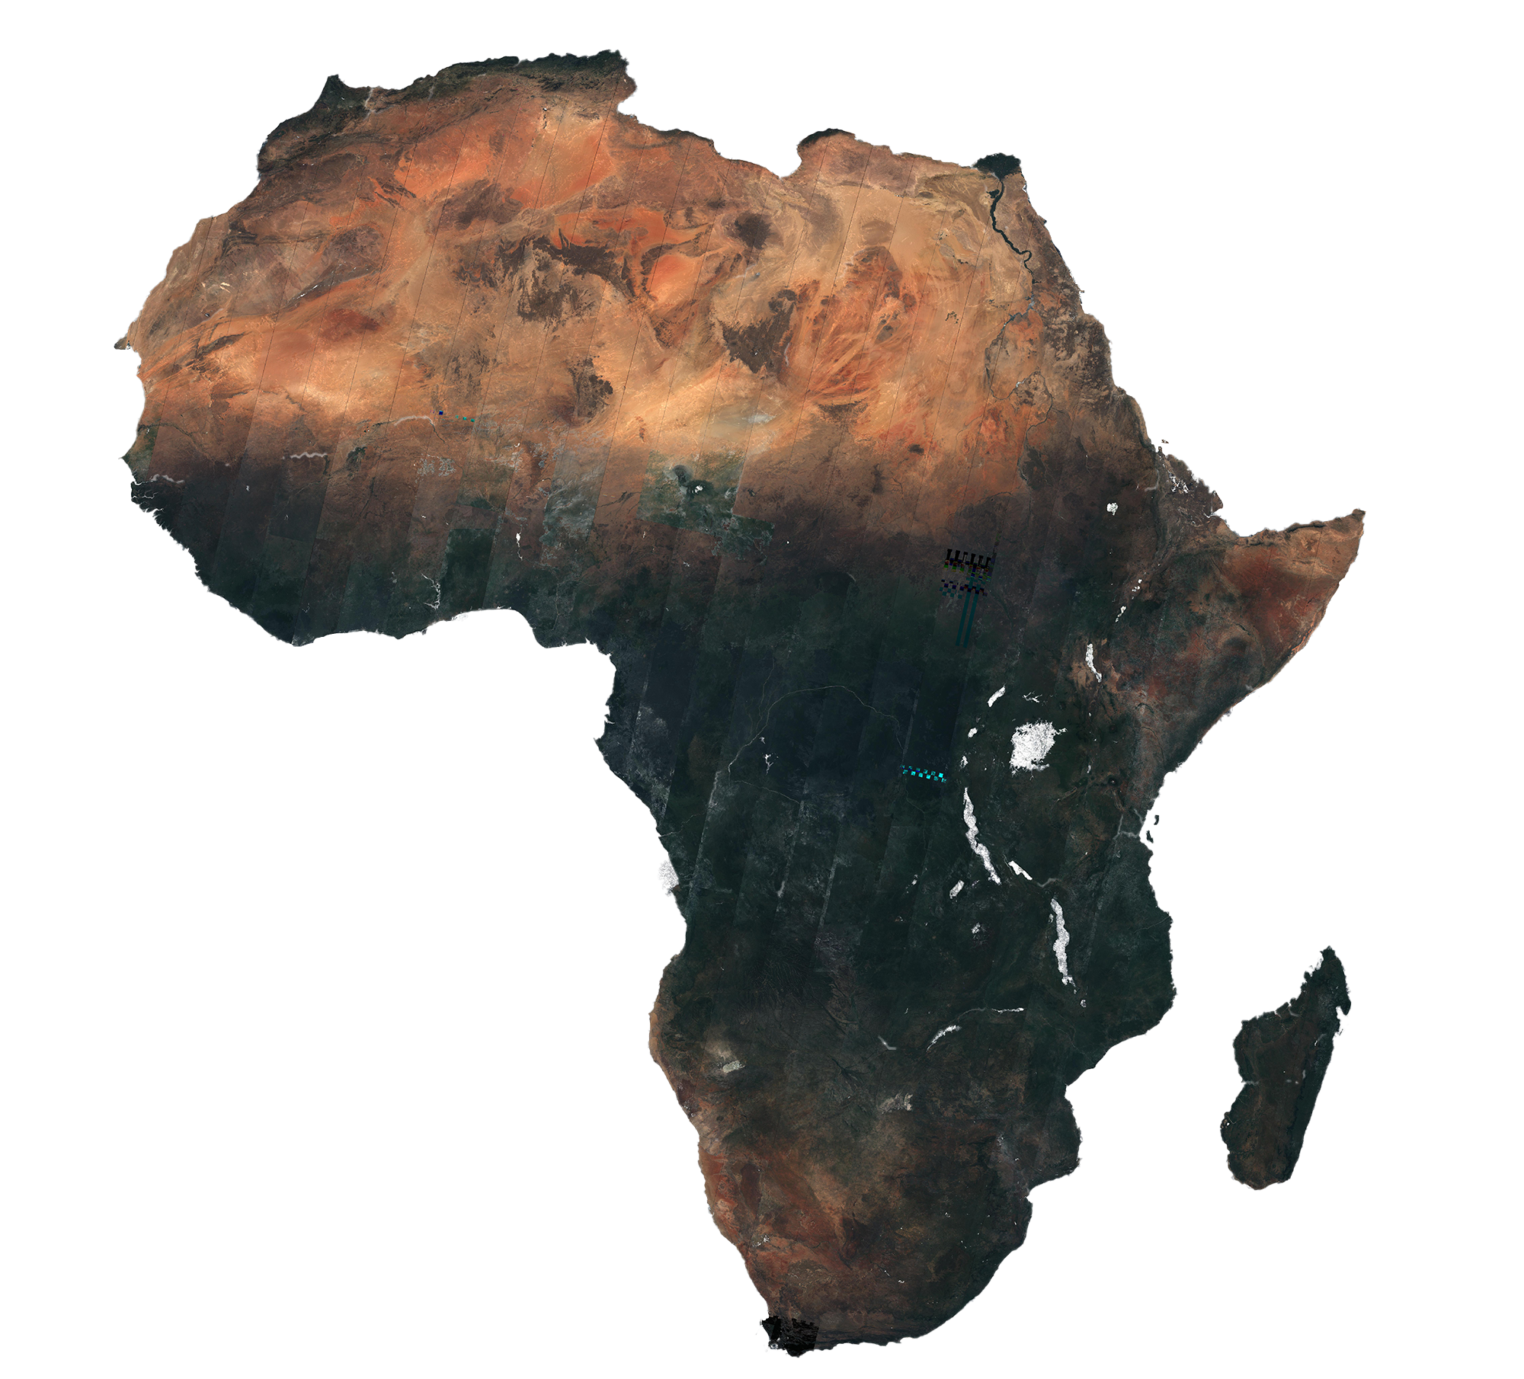
II.4.2.Water & Natural Resources
II.4 GMES & AFRICA INFORMATION SERVICES SYSTEM
Consortia x Systems

Slide 18
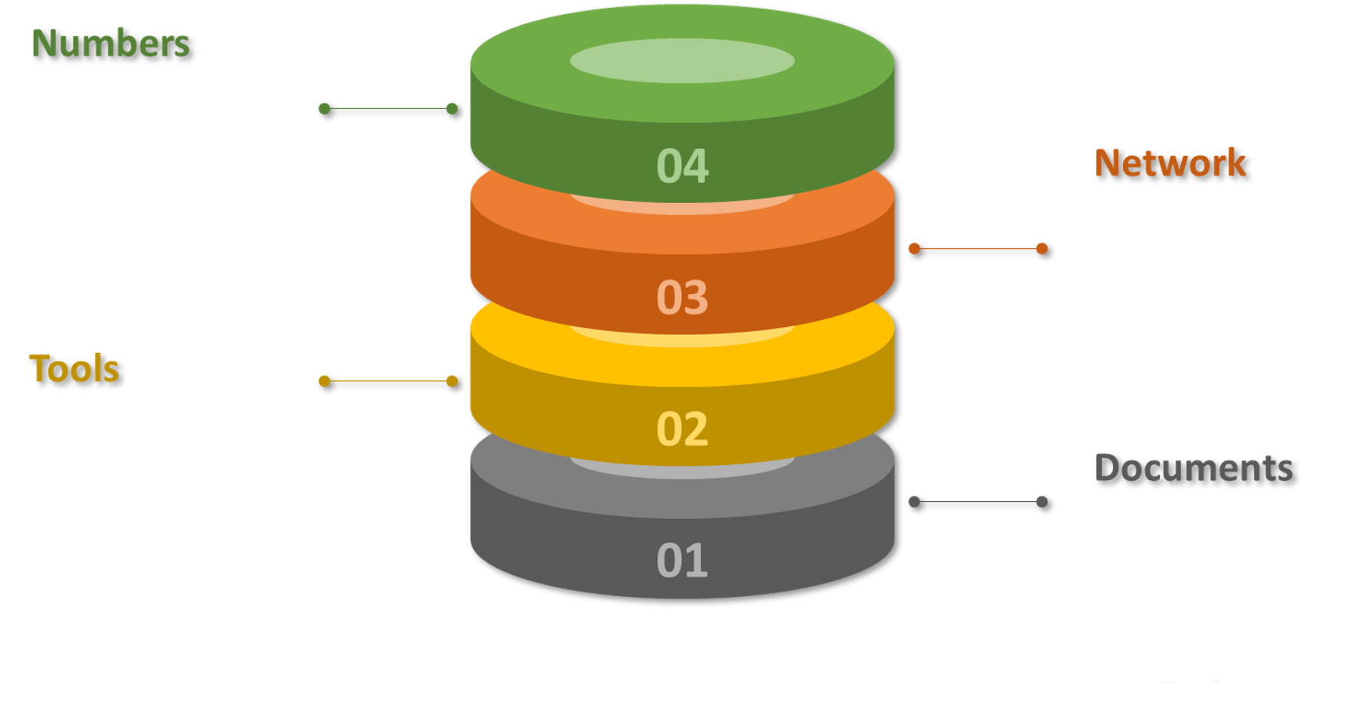
III. TRAINING SYSTEM: NATIONAL, REGIONAL AND CONTINENTAL
5,000 participants
20,000 days of training
100 training delivered
46 scholars (PhD and Masters)
30+ Francophone and Anglophone Universities
AUC GMES and Africa Distance Learning Platform
http://gmestraining.africa-union.org
Training Strategy
Training Catalogue (Identification of needs)
Mapping of existing capacities
Notes:
Training needs have been drawn up by the PMU with consortia and partners (training catalogue)
The implementation of training has been ensured in the same way, PMU, leaders, JRC, EUMETSAT, separately or together, or by the training centers that are stakeholders of the consortia (CRASTE-LF, CURAT, Makerere etc.).
For some areas, this training has been subcontracted to the private sector, particularly in Africa (AFEOS, CRREBAC, GEOMIK, LOCATE-IT)

Slide 19
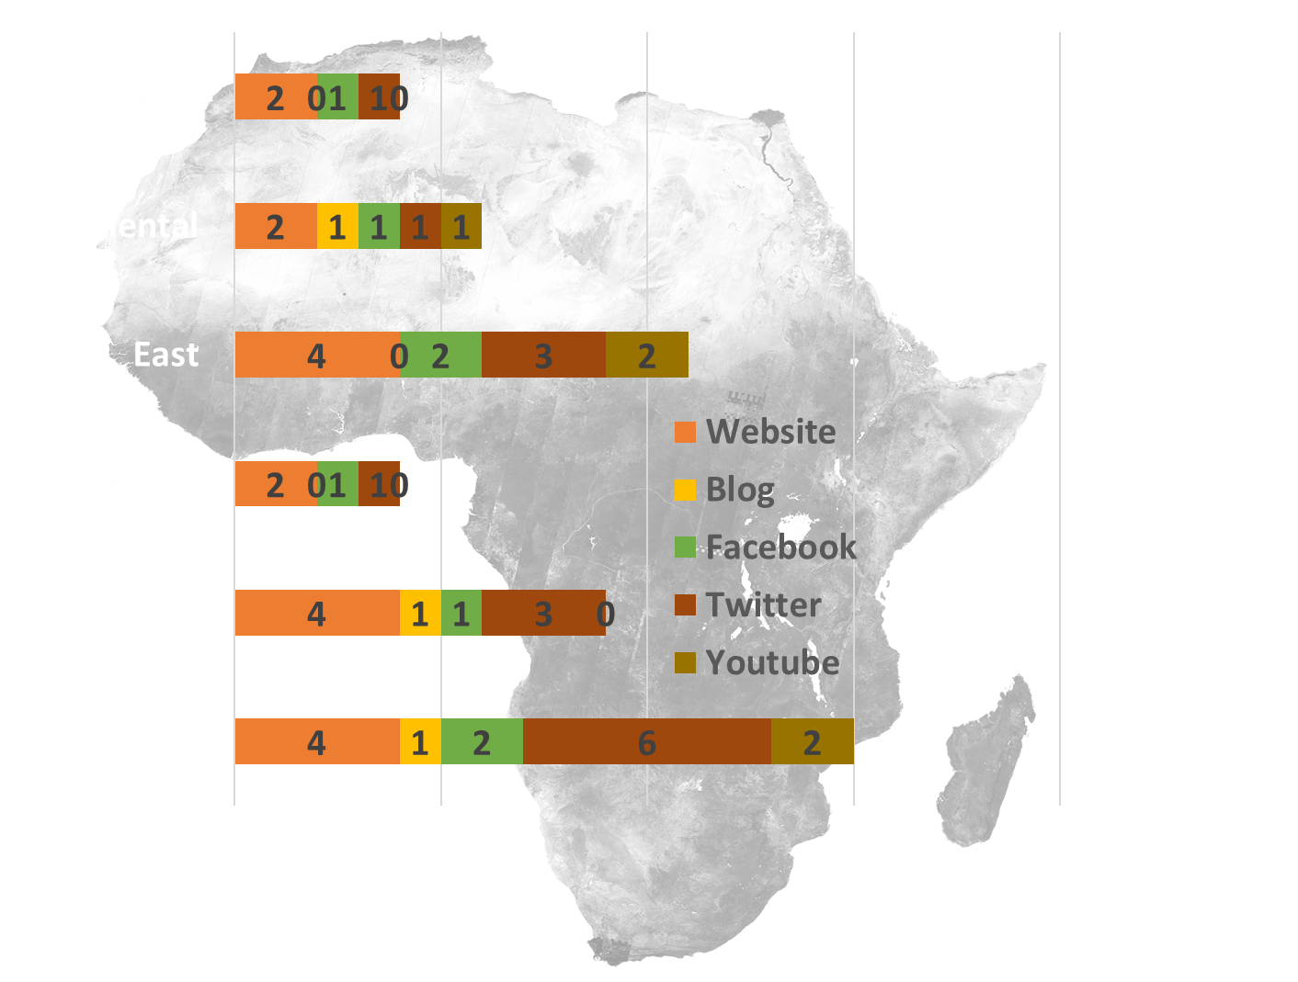

IV. RAISE AWARENESS AMONG USERS AND COMMUNITIES
452 Articles
37,617 Total visitors
207,115 Page views
https://gmes4africa.blogspot.com
2696 Followers
50 Communication platforms
Notes:
50 plateformes de communications

Slide 20

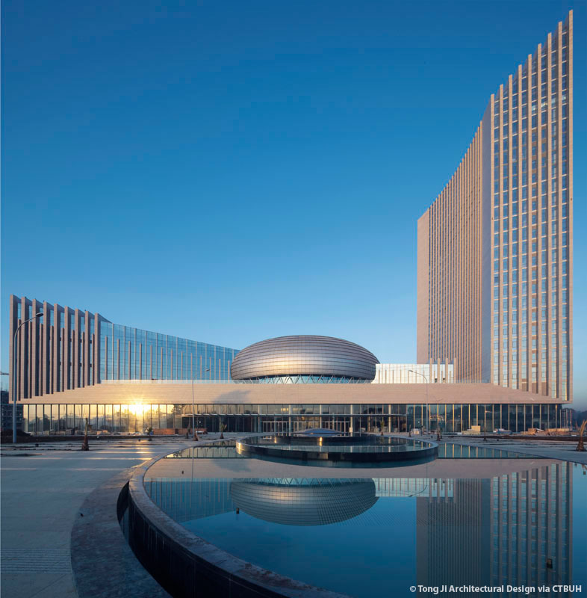

THANK YOU
AFRICAN UNION COMMISSION
Department of Education, Science, Technology and Innovation (ESTI)
Po Box 3243 | Roosevelt Avenue (Old Airport Area) | WK21K19
Addis Ababa, Ethiopia
Notes:
Slide Contacts and Addresses

